Slide 1

Reduced-cost EnKF for parameter estimation of microscale atmospheric pollutant dispersion models
Eliott Lumet¹, Mélanie Rochoux¹, Thomas Jaravel¹ and Simon Lacroix²
              ¹CECI, CNRS, CERFACS, Toulouse, France
              ²LAAS, CNRS, Toulouse, France
18/06/2024

Slide 2
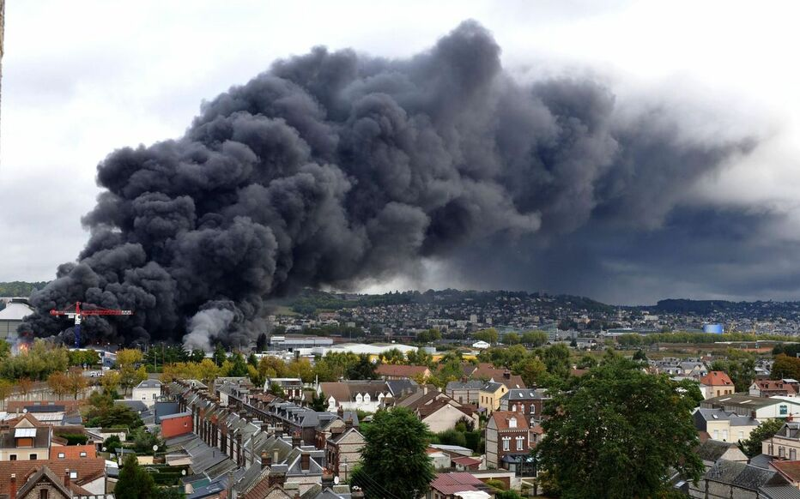
Context
Pollutant dispersion is involved in many applications related to safety/public health (industrial accident, traffic air pollution, wildfire smoke)
Focus on microscale dispersion in urban environments
Large-eddy simulation (LES) modeling
  Resolves the largest turbulence scales
  Explicitly accounts for the effect of urban buildings on the atmospheric flow and dispersion
  Provides a spatio-temporal description of the phenomenon
Lubrizol factory fire in Rouen in September 2019
LP/JEAN PIERRE MAUGER
  LES still has large uncertainty despite its substantial computational cost (Dauxois et al. 2021)
General objective
Implement a reduced-cost DA system to reduce uncertainty in LES modeling of urban pollutant dispersion

Slide 3
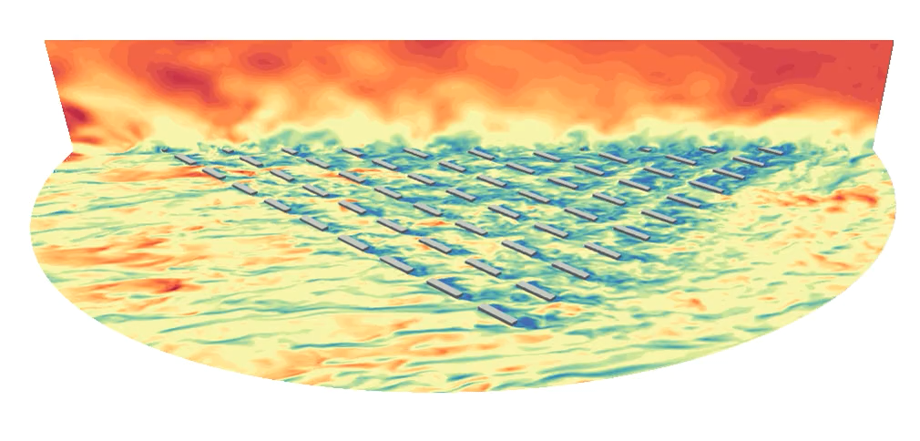

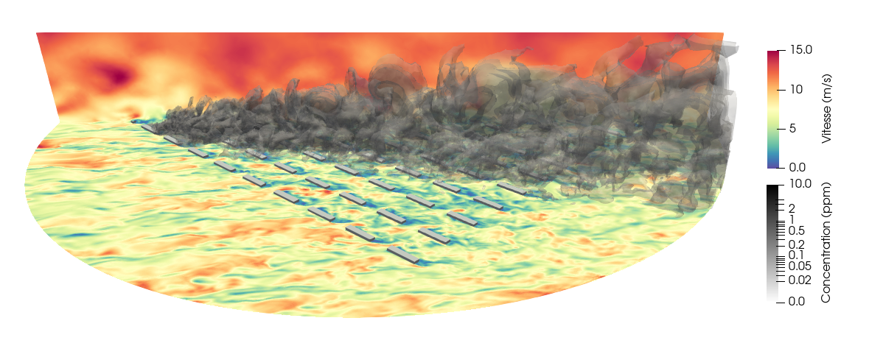
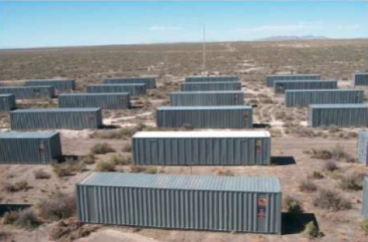
Context
Case study: LES of the MUST field campaign trial #2681829 (Yee and Biltoft. 2004)
Wind speed (m.s⁻¹)
Concentration (ppm)

Slide 4
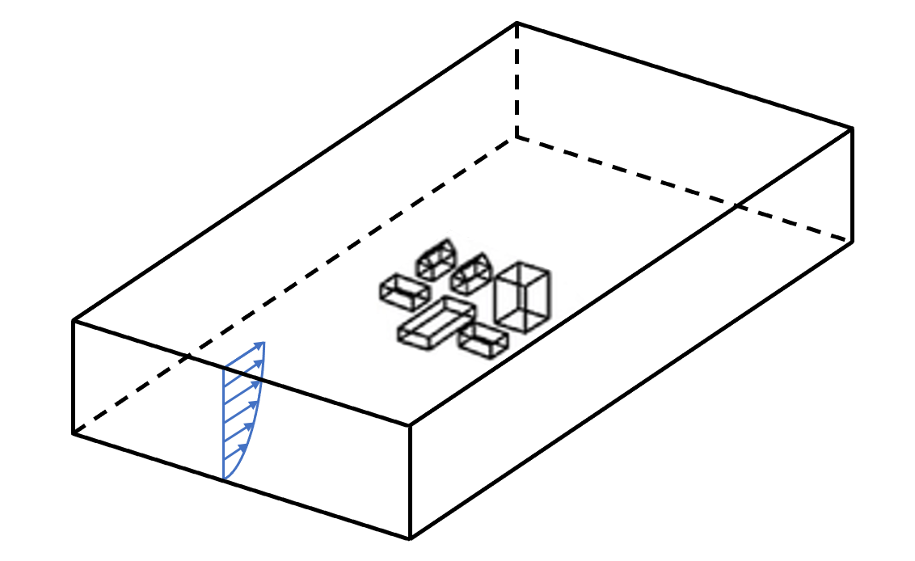
Context
Uncertainty in LES microscale dispersion modeling
Meteorological
Meteorological
Boundary conditions
Pollutant source
Epistemic uncertainty
Urban geometry
Structural
- Subgrid-scale model
- Numerical scheme
Aleatory uncertainty
Microscale internal variability of the ABL
Microscale internal variability of the ABL
Focus on uncertainties related to atmospheric conditions
Notes:
Internal variability is thought to account for a significant proportion of CFD model errors and it has been less studies than epistemic uncertainties (Schatzmann et al. 2011, Dauxois et al. 2021)

Slide 5
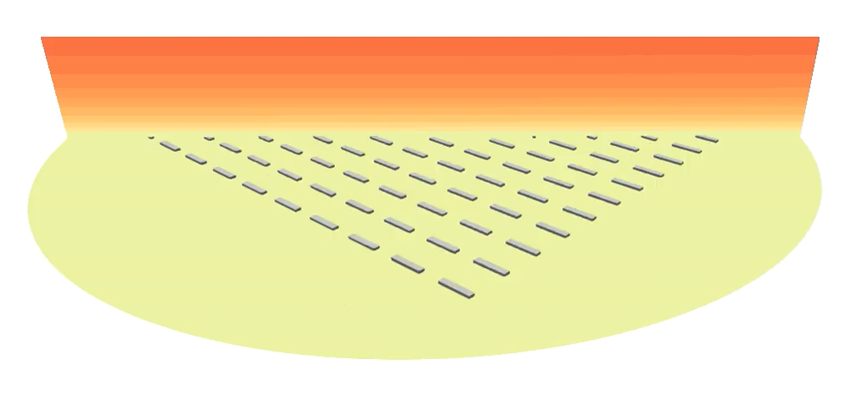
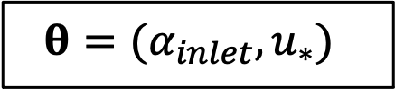
Approach
State estimation versus parameter estimation
*Mons et al. 2017, Sousa et al. 2018, Sousa et Gorlé. 2019, Defforge et al. 2019, Defforge et al. 2021.
Control vector definition:
At the microscale, initial conditions have low persistence
⇒ More relevant to estimate boundary condition parameters*
Inlet boundary condition
Uniform initial conditions
$$θ=(α_{inlet}, u_{∗})$$
Inlet wind direction
Inlet wind friction velocity

Slide 6
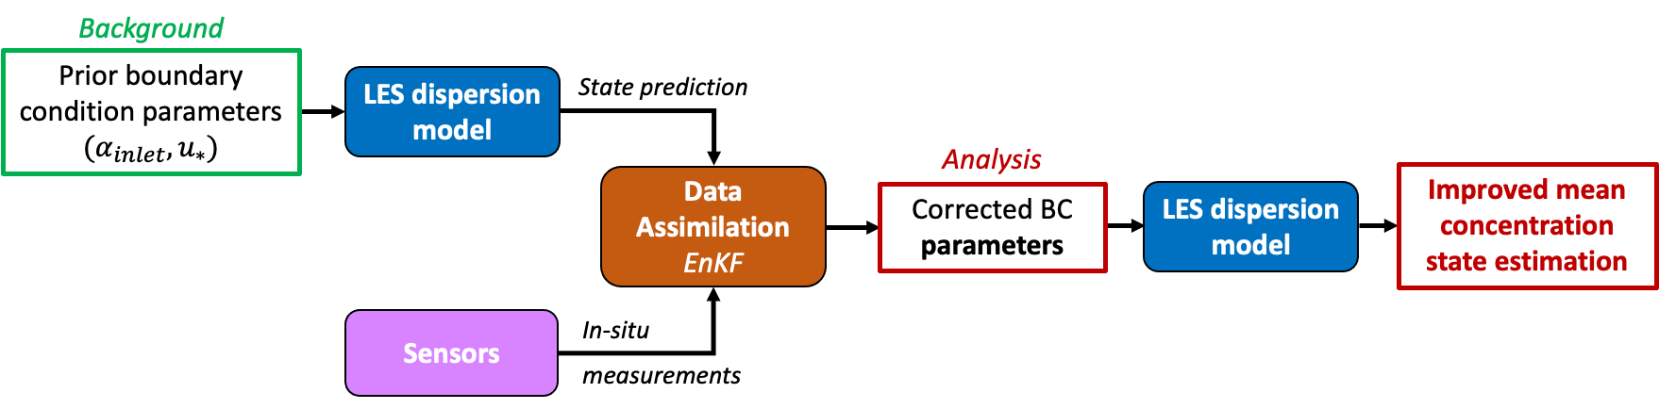
Objectives
Data assimilation system design
  Epistemic uncertainty on boundary condition parameters: ✓
  Aleatory uncertainty associated with the internal variability: ✗
Mons et al. 2017, Sousa and Gorlé. 2019, Defforge et al. 2021
Objective #1
  Take account of aleatory uncertainty linked to internal variability in the assimilation system

Slide 7
Objectives
Effect of the internal variability of the ABL on the mean concentration predictions
  Estimation using stationary bootstrap of LES sub-averages (Lumet et al. 2024)

Slide 8
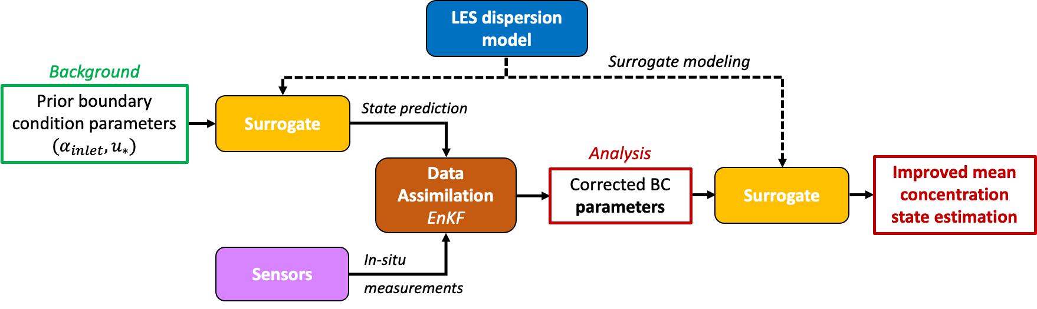
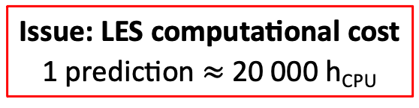
Objectives
Data assimilation system design
Issue: LES computational cost
1 prediction $≈$ 20 000 h_{CPU}
Objective #2
  Build a surrogate model to reduce the cost of the DA system without compromising the accuracy of its estimates

Slide 9
Contents
Reduced-cost DA system
Assimilation of the real field measurements

Slide 10
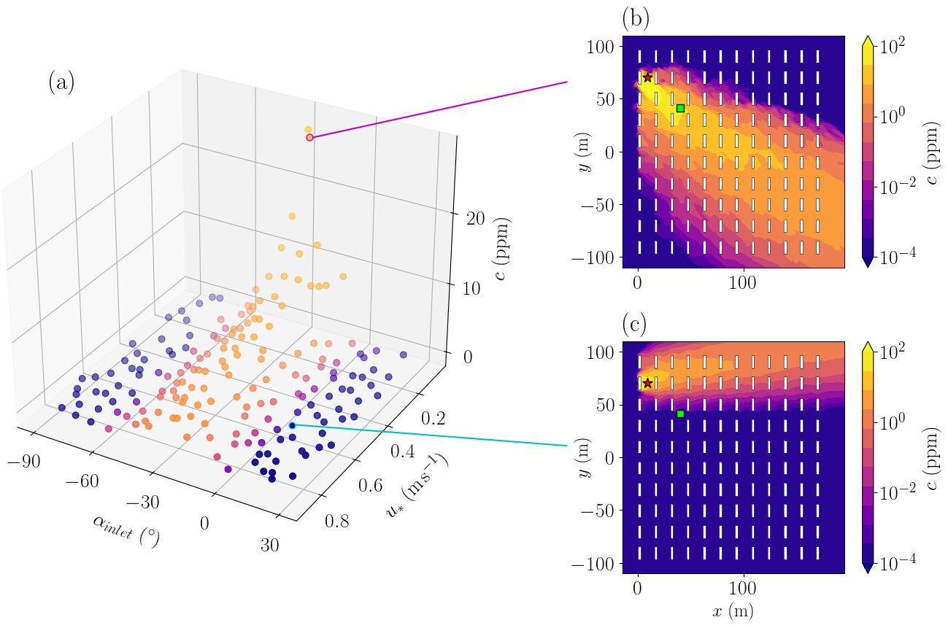
I – Reduced-cost DA system
Construction of the surrogate model
  Computation of a dataset of 200 LES using Halton’s sequence to sample the control vector space
The dataset is being put online in open access on Zenodo

Slide 11
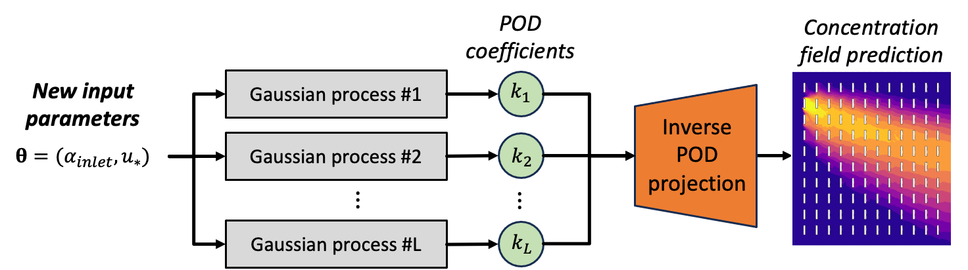
I – Reduced-cost DA system
Construction of the surrogate model
  Train a POD—GPR surrogate model (Marrel et al. 2015) over 160 LES samples
    Dimension reduction step using Proper Orthogonal Decomposition (POD, a.k.a PCA)
    Learn the dependency of POD coefficients on the control vector using Gaussian Process Regression (GPR)
  Validation against 40 independent LES test samples
    Surrogate error close to the minimal level of error reachable given the LES internal variability
Article presenting the validation of the surrogate model currently being submitted to Building and Environment

Slide 12
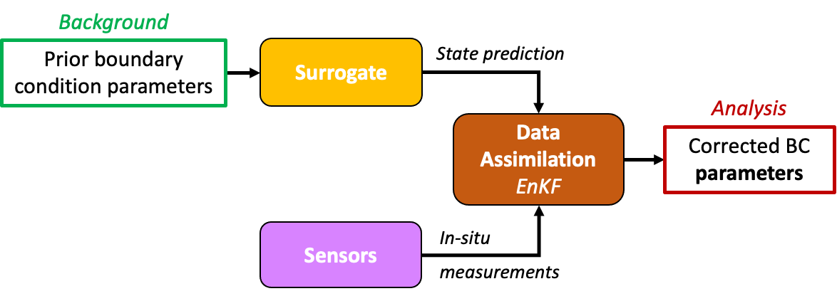
I – Reduced-cost DA system
Errors modeling for the MUST case
What is the surrogate model error?

Slide 13
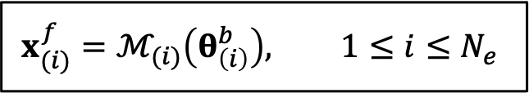

I – Reduced-cost DA system
Taking into account model error
  During the EnKF prediction step:
    With $ℳ_{(i)}$ a random sample from the POD—GPR distribution
$$x_{(i)}^{f}=ℳ_{(i)}\left(θ_{\left(i\right)}^{b}\right), 1≤i≤N_{e}$$
We show that the POD—GPR variance covers
  The regression error of each GP
  The aleatory uncertainty associated with internal variability
This approach integrates the spatial correlations of the errors

Slide 14
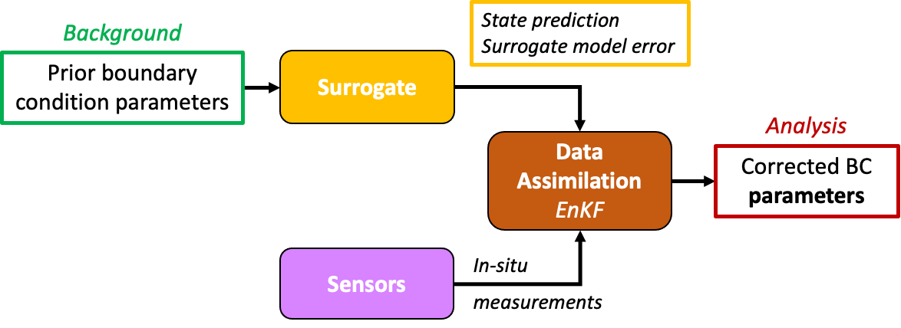
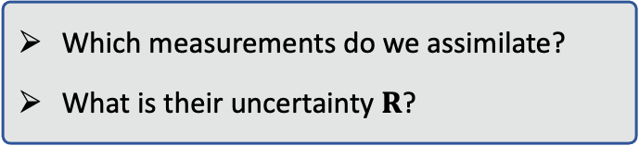
I – Reduced-cost DA system
Errors modeling for the MUST case
✓
Which measurements do we assimilate?
What is their uncertainty $R$?

Slide 15

I – Reduced-cost DA system
  Observation vector $y^{o}=\{$13 mean concentration measurements from 4 masts as in Defforge et al. 2021$\}$
  Observation error $e^{o} =measurmeent error+internal variability error$
  Observation error covariance matrix $R=$ estimated using stationary bootstrap (Lumet et al. 2024)
We can also take into account for spatial correlations of observation errors

Slide 16
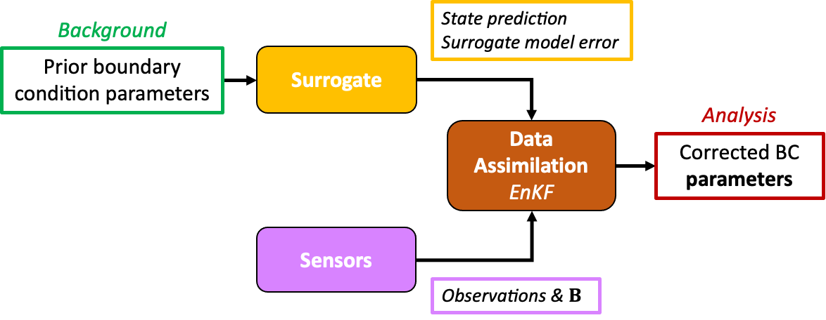
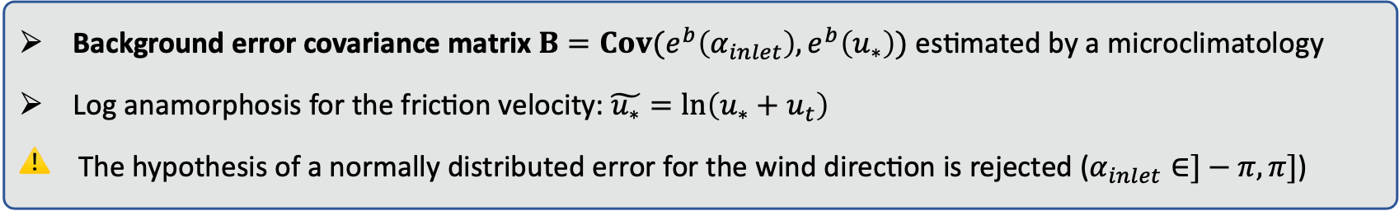
I – Reduced-cost DA system
Errors modeling for the MUST case
✓
✓
Background error covariance matrix $B=Cov(e^{b}\left(α_{inlet}\right),e^{b}\left(u_{∗}\right))$ estimated by a microclimatology
Log anamorphosis for the friction velocity: $\tilde{u_{∗}}=\ln\left(u_{∗}+u_{t}\right)$
⚠️ The hypothesis of a normally distributed error for the wind direction is rejected ($α_{inlet}∈]−π,π]$)

Slide 17

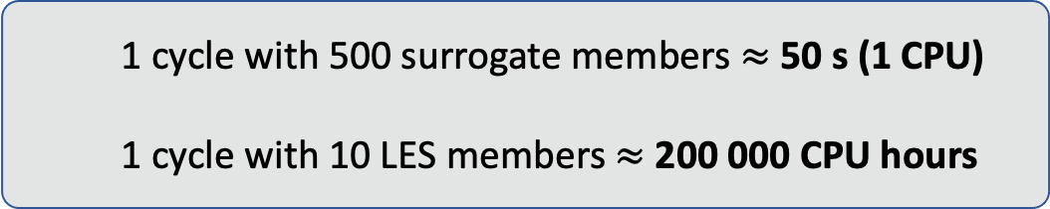

I – Reduced-cost DA system
Ensemble size selection using OSSEs
  Compromise between accuracy and computational cost $⇒$
$$N_{e}=500$$
  1 cycle with 500 surrogate members $≈$ 50 s (1 CPU)
  1 cycle with 10 LES members $≈$ 200 000 CPU hours
  Using a surrogate model and large ensemble also allows us to:
    Reduce sensitivity to background sampling
    Perform a large number of tests to optimize the DA system and investigate its sensitivities

Slide 18
Contents
Reduced-cost DA system
Assimilation of the real field measurements

Slide 19

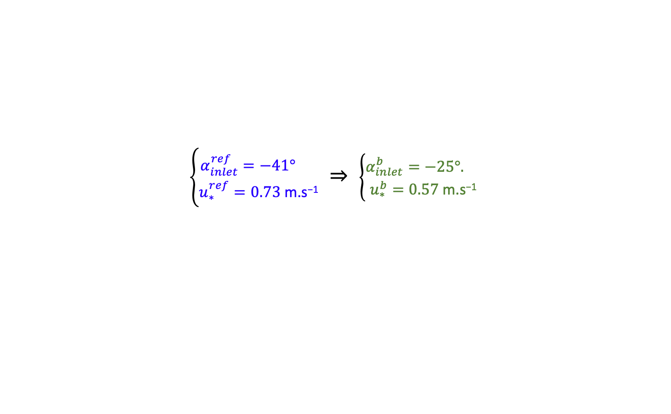
II – Assimilation of the real field measurements
Prior parameters
  $θ^{b}$ obtained by biasing the reference measurements $θ^{ref}$ defined using the nearest meteorological measurement masts (non-assimilated)
$\left\{\begin{aligned}α_{inlet}^{ref}=−41° \\ u_{∗}^{ref}=0.73 \text{m}\text{.}\text{s}\text{−1}\end{aligned}\right.$ $⇒$ $\left\{\begin{aligned}α_{inlet}^{b}=−25°. \\ u_{∗}^{b}=0.\text{57} \text{m}\text{.}\text{s}\text{−1}\end{aligned}\right.$
Reference
Background

Slide 20

II – Assimilation of the real field measurements
Control vector estimation
The EnKF estimates very well $α_{inlet}$
The analysis does not improve $u_{∗}$ estimation
The analysis error covariance is coherent:
  Uncertainty on $α_{inlet}$ is reduced
  Uncertainty on $u_{∗}$ is unchanged

Slide 21
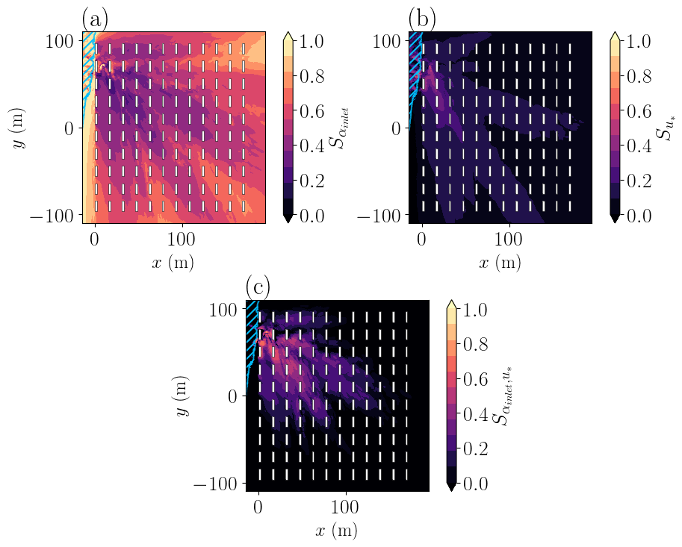

II – Assimilation of the real field measurements
Sensitivity of the mean concentration to the control vector
  Sensitivity analysis using Sobol’ indices
The EnKF fails to estimate $u_{∗}$ because the observation space is less sensitive to this parameter
The dependence on $u_{∗}$ is mostly conditioned by $α_{inlet}$
Perspective: using a an iterative estimation procedure?

Slide 22
II – Assimilation of the real field measurements
Propagation to state estimation – Validation against measurements
Correction of boundary condition parameters significantly improves concentration estimation, even at unobserved locations

Slide 23
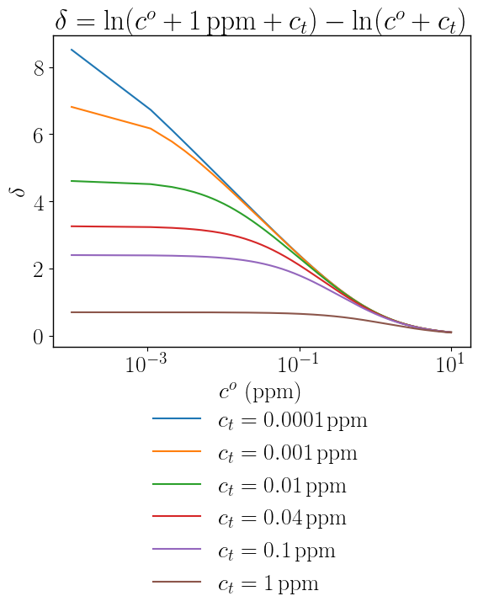
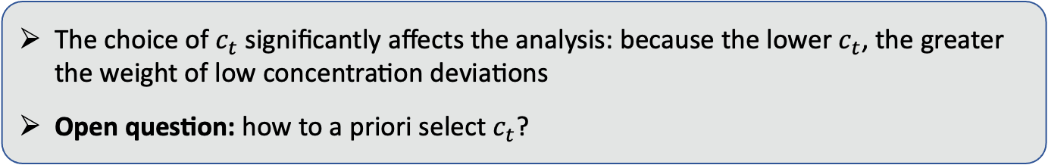
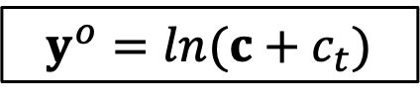
II – Assimilation of the real field measurements
$y^{o}=ln(c+c_{t})$
⚠️ Sensitivity to the concentration anamorphosis threshold:
The choice of $c_{t}$ significantly affects the analysis: because the lower $c_{t}$, the greater the weight of low concentration deviations
Open question: how to a priori select $c_{t}$?

Slide 24
II – Assimilation of the real field measurements
Propagation to state estimation – Vertical profiles estimation
The analysis may locally degrade concentration estimation
Parameter estimation cannot compensate for internal LES model biases

Slide 25
Conclusion and perspectives
Summary
Application of a reduced-cost EnKF for reducing uncertainty in microscale pollutant dispersion modeling
  We provided realistic error models that account for internal variability
  The use of a surrogate model allows us to provide large-ensemble analysis in a very short time (< 1min)
  The DA system successfully corrects wind direction from real concentration measurements
  It has difficulties for inferring friction velocity and cannot correct for internal LES model bias
Perspectives
Analyze the influence of using realistic error models
Move to joint state-parameter estimation to correct for internal LES model biases
Investigate the sensitivity to observation location to develop optimal sensor network design

Slide 26
References
Dauxois et al. (2021). Confronting Grand Challenges in Environmental Fluid Mechanics
Lumet (2024). Assessing and reducing uncertainty in large-eddy simulation for microscale atmospheric dispersion
Lumet et al. (2024). Assessing the Internal Variability of Large-Eddy Simulations for Microscale Pollutant Dispersion Prediction in an Idealized Urban Environment. Boundary-Layer Meteorology
Marrel et al. (2015). Development of a surrogate model and sensitivity analysis for spatio-temporal numerical simulators
Mons et al. (2017). Data assimilation-based reconstruction of urban pollutant release characteristics
Schatzmann and Leitl. (2011). Issues with validation of urban flow and dispersion CFD models
Sousa et al. (2018). Improving urban flow predictions through data assimilation
Sousa et Gorlé. (2019). Computational urban flow predictions with Bayesian inference: Validation with field data
Defforge et al. (2019). Improving CFD atmospheric simulations at local scale for wind resource assessment using the iterative ensemble Kalman smoother
Defforge et al. (2021). Improving Numerical Dispersion Modelling in Built Environments with Data Assimilation Using the Iterative Ensemble Kalman Smoother
Yee and Biltoft (2004). Concentration Fluctuation Measurements in a Plume Dispersing Through a Regular Array of Obstacles

Slide 27
Appendices

Slide 28
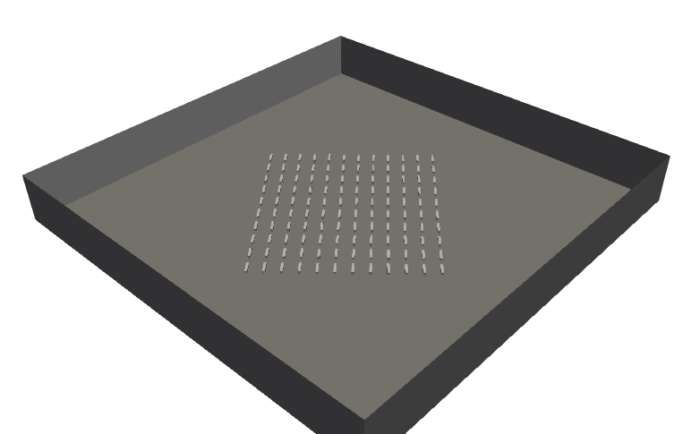
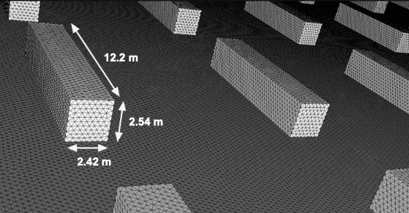


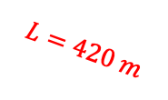


Appendices
Model set-up
  Solver: AVBP - LES for compressible flows and low Mach number
  Sub-grid Scale Model: WALE (tailored for boundary-layers)
  Numerical scheme: Lax-Wendroff (2nd Order – FVM)
  Pressure Gradient Scaling: to reduce the CFL constraint
  Turbulence injection: Kraichnan-Celik method
  Mesh: unstructured, 90 million tetraedra
    Refinement near the walls:
    30 cm $⇔$ At least 8 cells by obstacle edge
  Computational cost:
$$h=50 m$$
$$L=420 m$$
Inflow
Symmetry
$$d_{inlet}=80 m$$
Wall laws
Outflow
Symmetry
{60s spin-up + 200s}
$⟺$ 20 000 hCPU

Slide 29
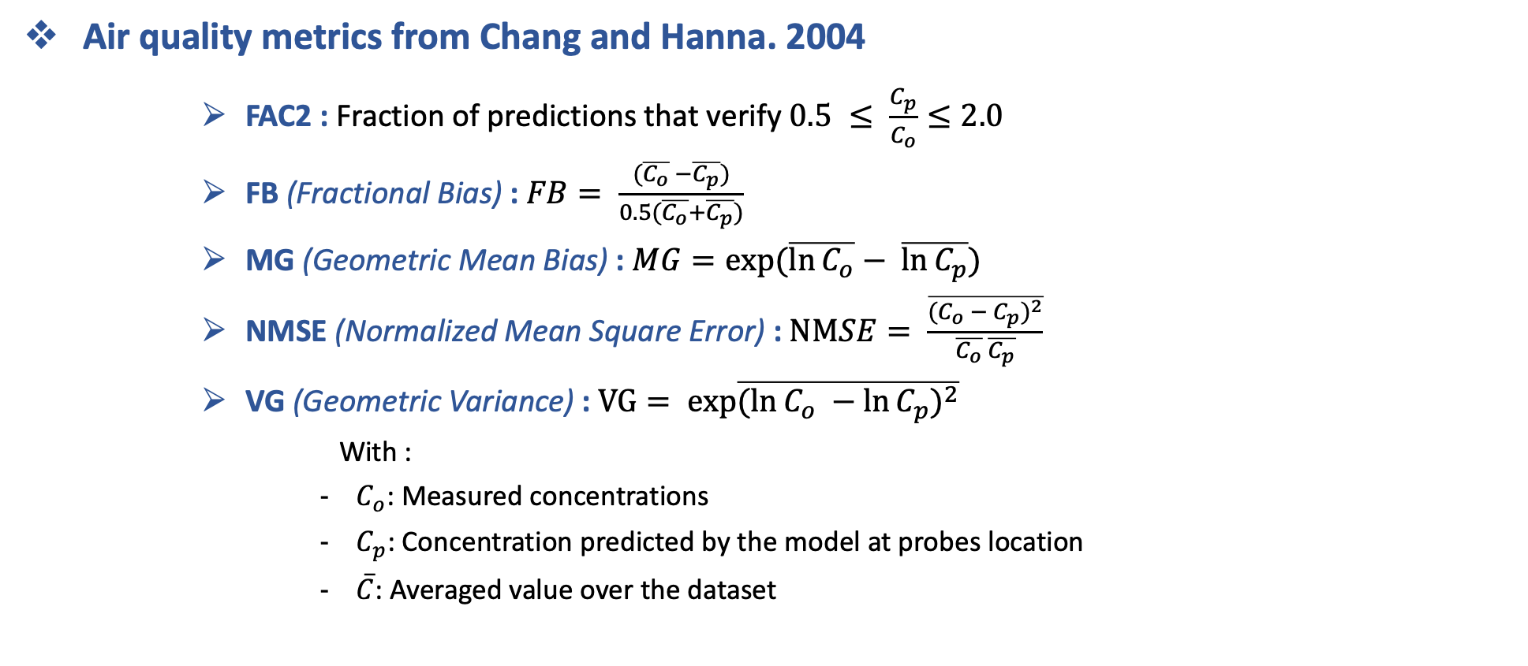
Appendices
Air quality metrics from Chang and Hanna. 2004
      FAC2 : Fraction of predictions that verify $0.5 ≤ \frac{C_{p}}{C_{o}}≤2.0$
      FB (Fractional Bias) : $FB= \frac{(\overline{C_{o}} −\overline{C_{p}})}{0.5(\overline{C_{o}}+\overline{C_{p}})}$
      MG (Geometric Mean Bias) : $MG=\exp{(\overline{\ln{C_{o}}}− \overline{\ln{C_{p}}})}$
      NMSE (Normalized Mean Square Error) : $NMSE= \frac{\overline{{(C_{o} − C_{p})}^{2}}}{\overline{C_{o}} \overline{C_{p}}}$
      VG (Geometric Variance) : $VG= exp{\overline{{(\ln{C_{o} −\ln{C_{p}}})}^{2}}}$
        With :
          $C_{o}$: Measured concentrations
          $C_{p}$: Concentration predicted by the model at probes location
          $\overline{C}$: Averaged value over the dataset

Slide 30
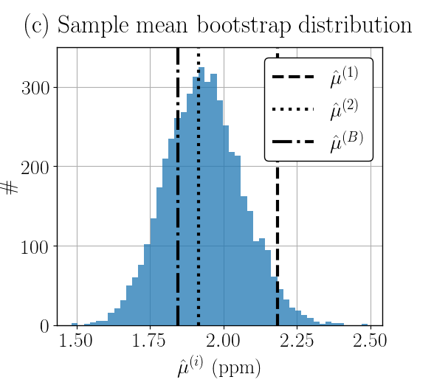
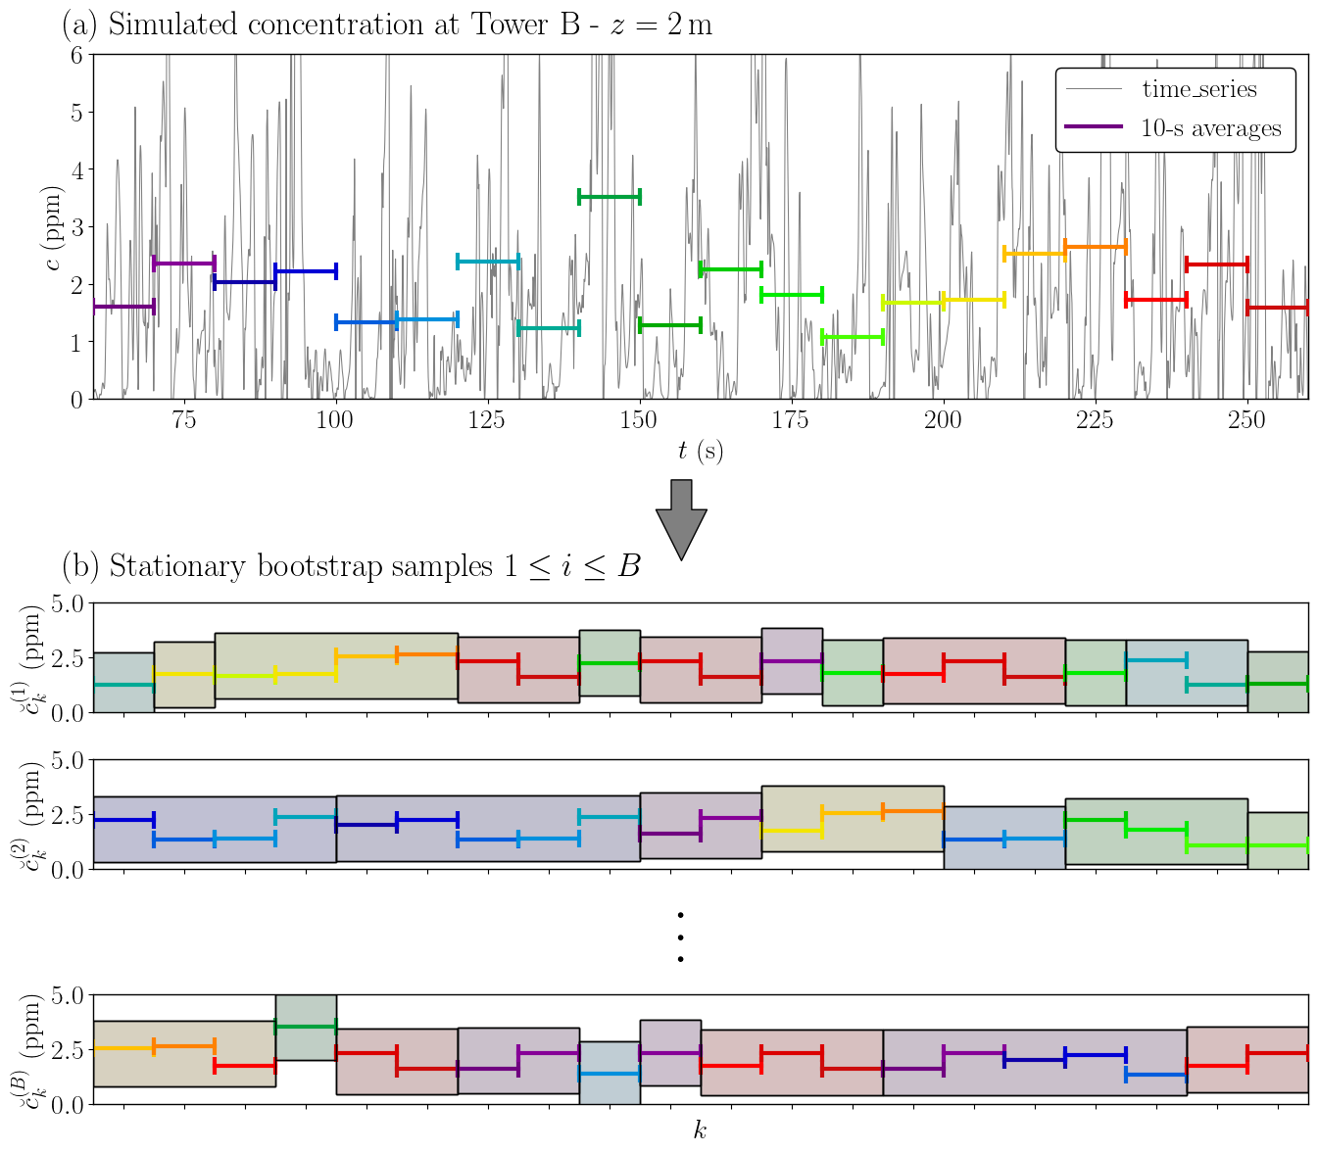
Appendices
Stationary bootstrap method used to quantify internal variability

Slide 31
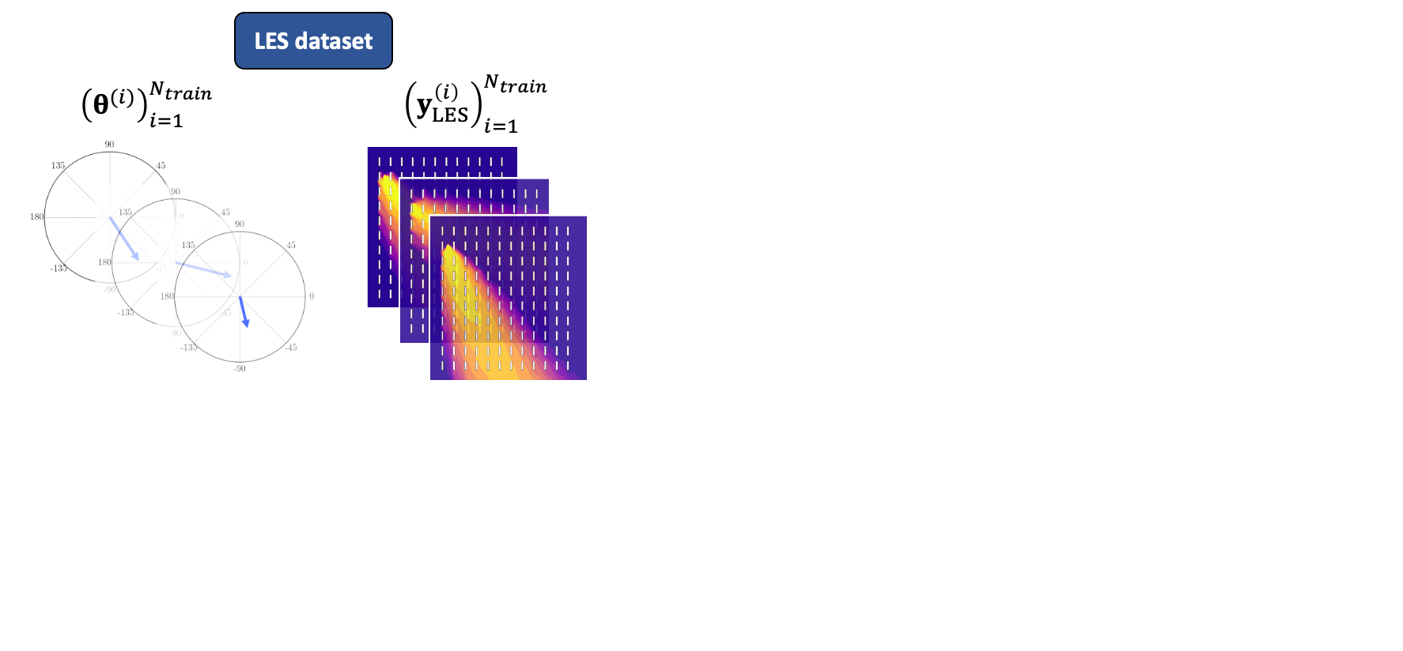
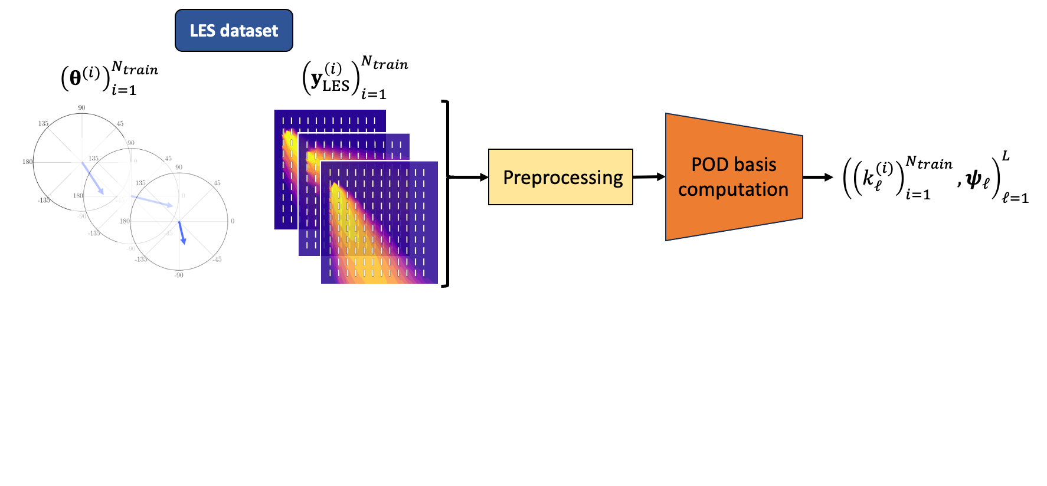
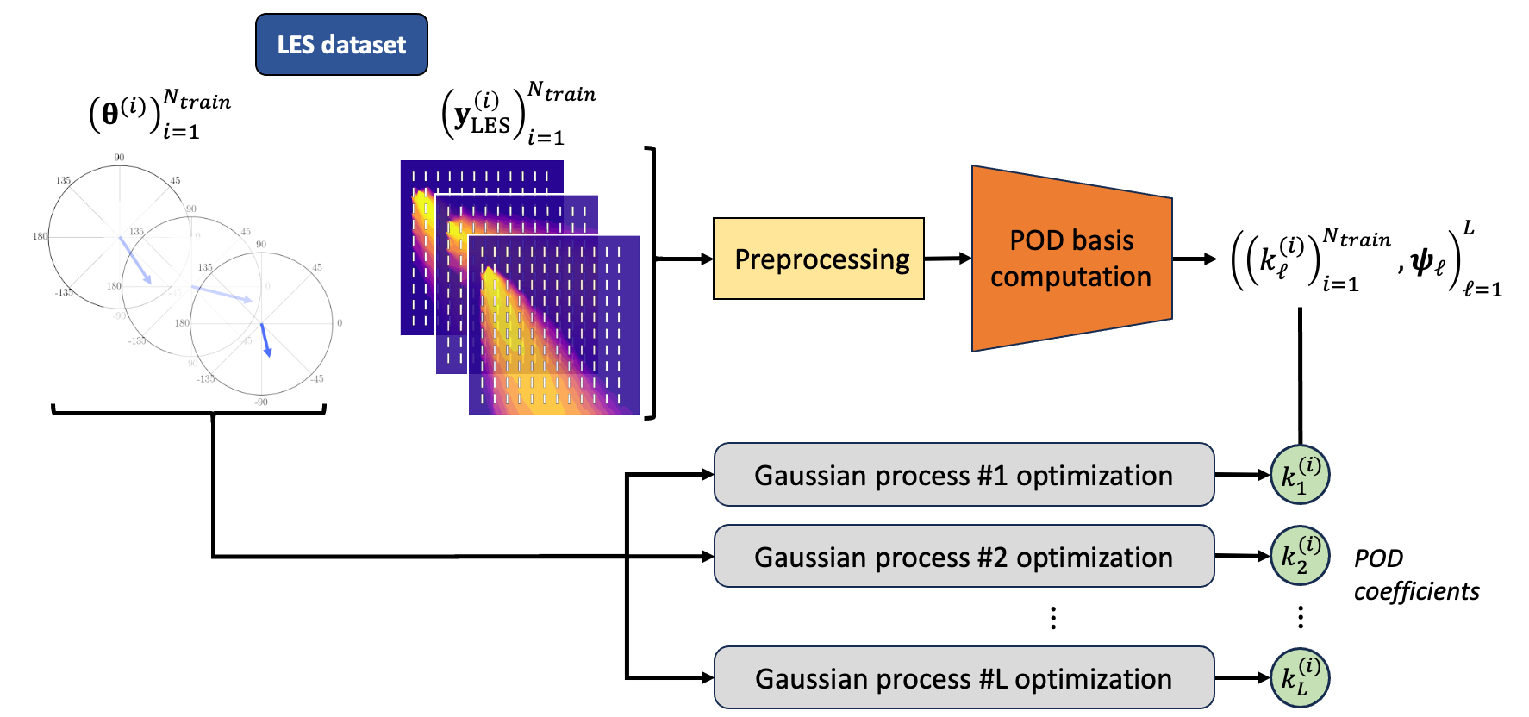
Appendices
Construction of the surrogate model
  Train a POD—GPR surrogate model (Marrel et al. 2015) over 160 LES samples
    Dimension reduction step using Proper Orthogonal Decomposition (POD, a.k.a PCA)
    Learn the dependency of POD coefficients on the control vector using Gaussian Process Regression (GPR)

Slide 32
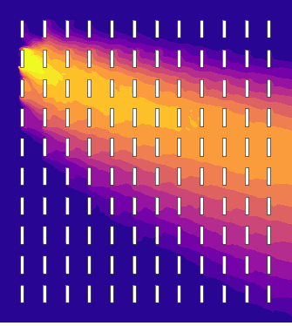






Appendices
Construction of the surrogate model
  Compute new prediction with the POD—GPR surrogate model
  Validation against 40 independent LES test samples
    Emulates well the LES response surface with an approximation error close to the minimal level of error reachable given the LES internal variability
POD coefficients
Concentration field prediction
New input parameters
Gaussian process #1
$$k_{1}$$
Inverse POD projection
$θ=(α_{inlet},u_{∗})$
Gaussian process #2
$$k_{2}$$
$$⋮$$
$$⋮$$
Gaussian process #L
$$k_{L}$$
Article presenting the validation of the surrogate model currently being submitted to Building and Environment

Slide 33
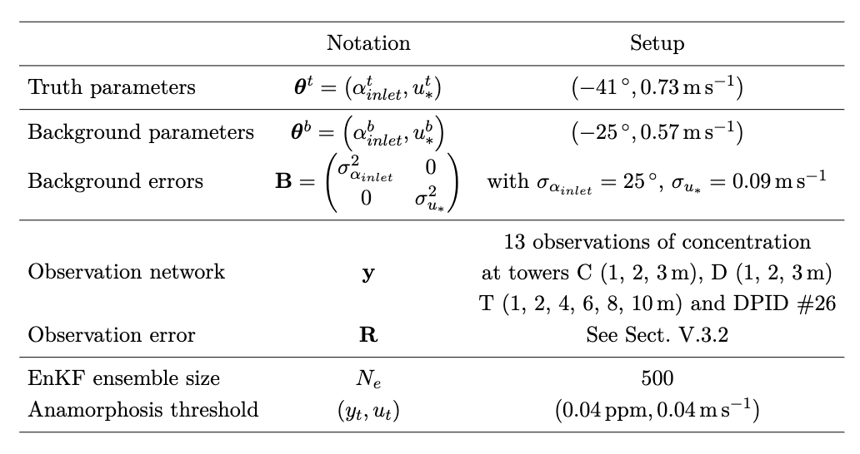
Appendices
Set-up used to assimilate the real field measurements

Slide 34
Appendices
Anamorphosis for friction velocity
$$\tilde{u_{∗}}=ln\left(u_{∗}+c_{t}\right)$$

Slide 35
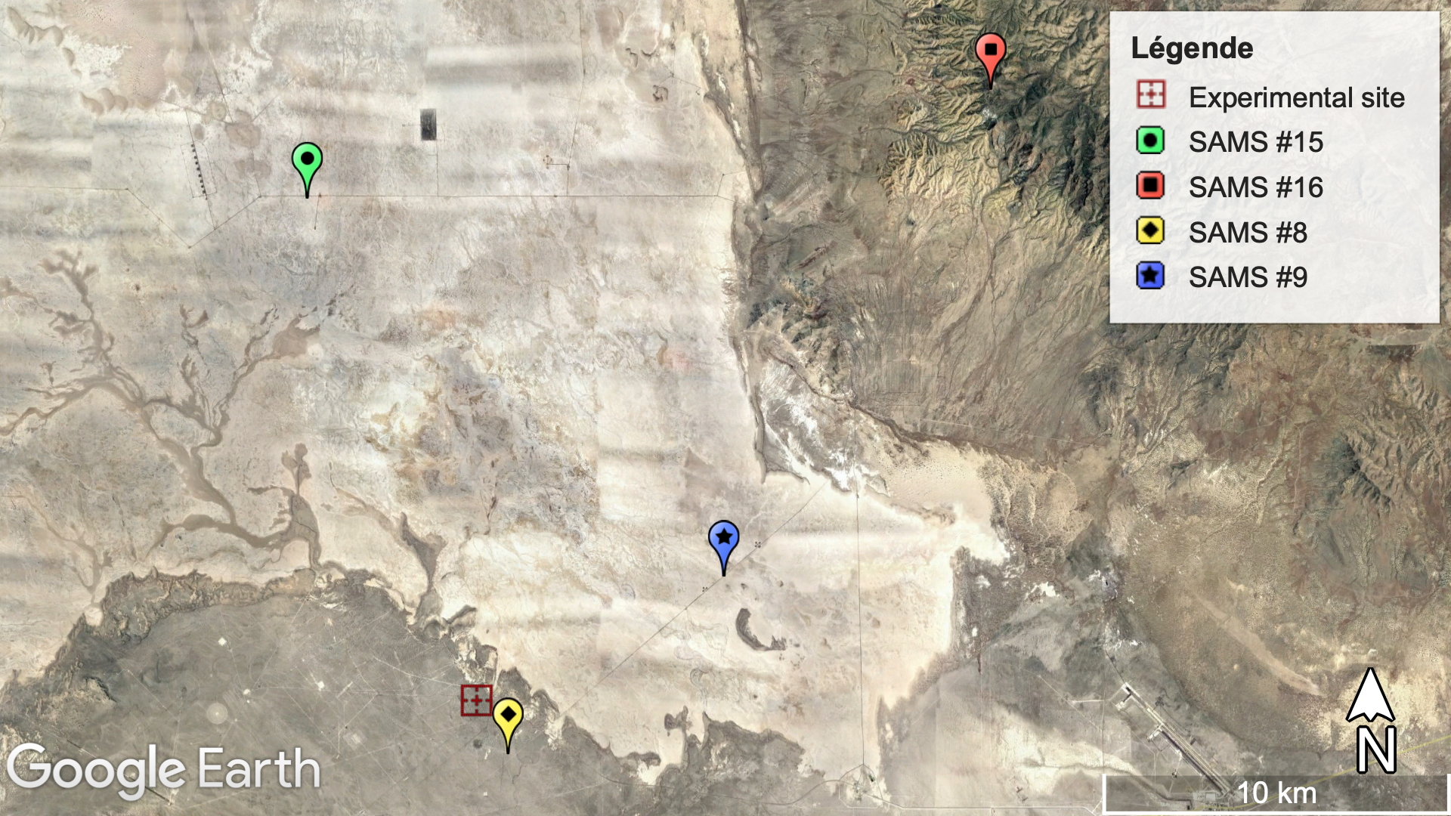
Appendices
Background error covariance matrix estimation
  Statistics based on 12 days of measurements of the difference between the two nearest masts

Slide 36
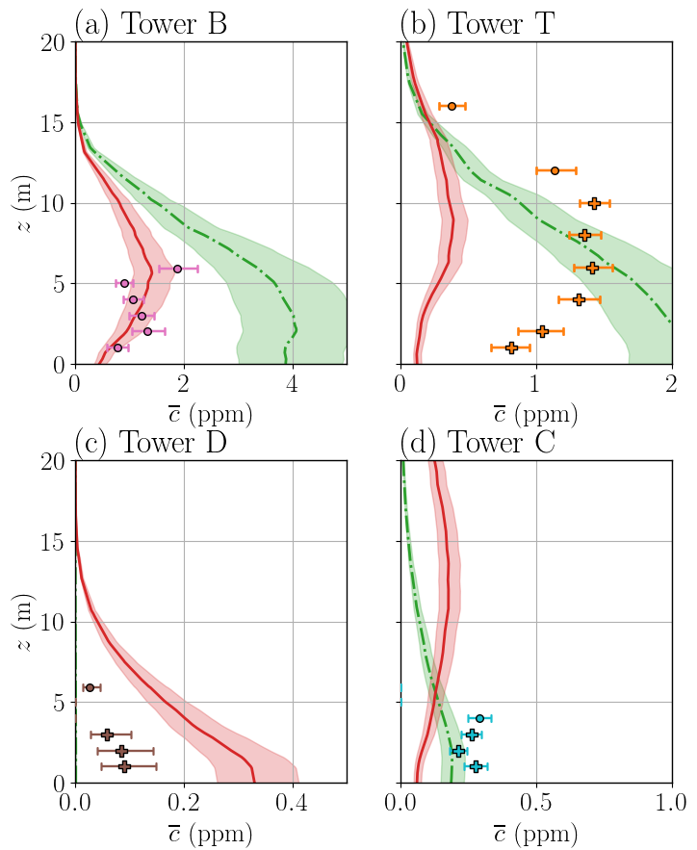
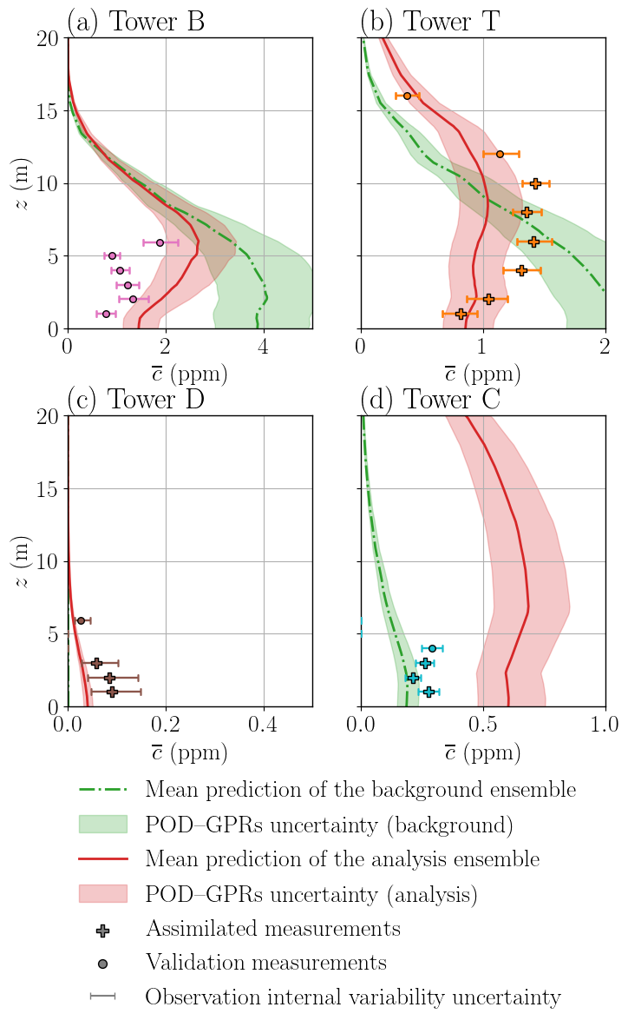


Appendices
Effect of the concentration anamorphosis threshold
$c_{t}=0.04$ ppm
$c_{t}=0.1$ ppm
16/10/2023

Slide 37
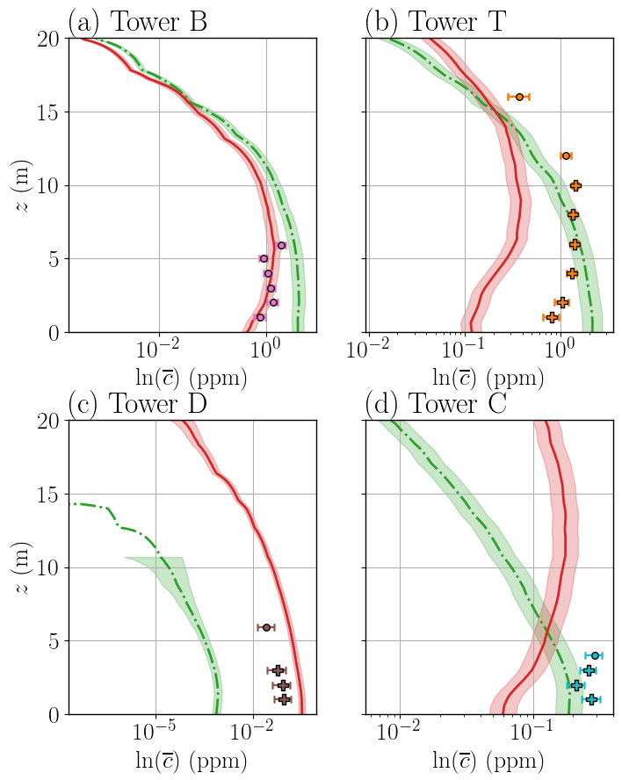
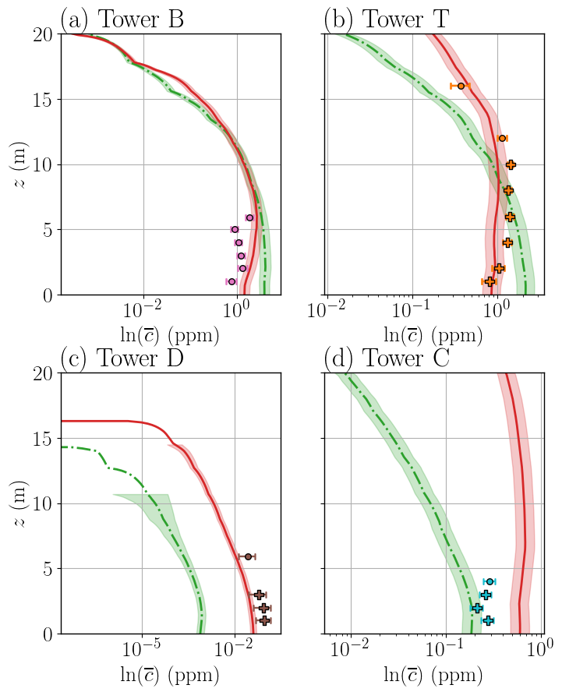
Appendices
Effect of the concentration anamorphosis threshold
$c_{t}=0.04$ ppm
$c_{t}=0.1$ ppm
En concentration log

