Slide 1
Data assimilation for microscale pollutant atmospheric dispersion
Eliott Lumet, Mélanie Rochoux, Thomas Jaravel, Simon Lacroix and Olivier Vermorel
HARMO21
27 september 2022

Slide 2
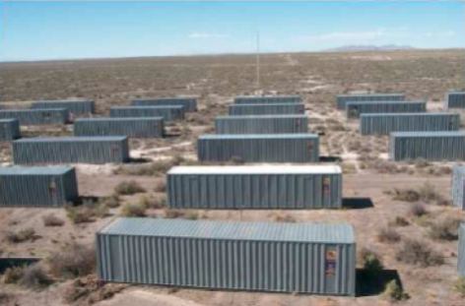
Introduction
Context: Build high-fidelity models for microscale dispersion in urban environment and improve them thanks to mathematical methods
Study case: One neutral trial of the MUST field campaign (Yee and Biltoft. 2004)
Large-Eddy Simulation (LES) model:
Realistic representation of the urban canopy
Resolution of turbulence large scales
Temporal evolution of the plume
Instantaneous concentration field timelapse obtained with LES of the MUST experiment #2681829
Eliott Lumet et al. 2022 – Data assimilation for microscale pollutant atmospheric dispersion

Slide 3
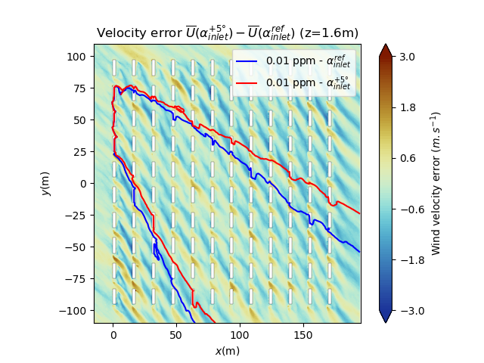
Introduction
Context: Build high-fidelity models for microscale dispersion in urban environment and improve them thanks to mathematical methods
$$α_{inlet}^{+5°}$$
$$α_{inlet}^{ref}$$
CFD dispersion model uncertainties:
Boundary
Conditions
Pollutant source
Modelling
error
These models may remain inaccurate in spite of
their high cost
$⇒$ Need for a stochastic approach to represent the envelope of possible events
Impact of the wind direction angle on the mean velocity field and on the 0.01-ppm contour line of average concentration
Eliott Lumet et al. 2022 – Data assimilation for microscale pollutant atmospheric dispersion

Slide 4
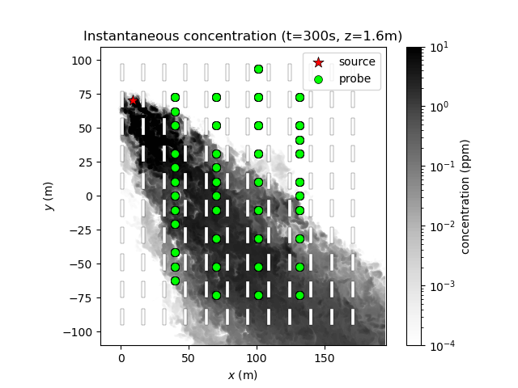
Introduction
Objective:
Develop a data assimilation framework to quantify and reduce the LES uncertainties
LES model
$$\overline{c^{b}}$$
DA
$$\overline{c^{a}}$$
Optimal plume
estimation
In situ measurements
$$y$$
Classical method in meteorology/climate
Emerging idea for atmospheric CFD models
ex: Lucas et al. 2015, Mons et al. 2017, Sousa et al. 2018, Defforge et al. 2019, Aristodemou et al. 2019

Slide 5
Introduction
Problem formulation
Objective: Estimate best the mean concentration field $\overline{c^{f}}$ given uncertain $\overline{c}$ and $y$
Issue #1: Parameter estimation
For steady state estimation, LES models depend more on parameters than initial conditions
$\overline{c^{f}}=ℳ(θ,c_{0})$
LES model estimation
In situ measurements
$⇒$ The estimation targets are the model parameters $θ$
$⇒$ Resolution of an inverse problem
Improved estimation of the parameters
$$θ^{b}$$
LES model
$$\overline{c^{b}}$$
Prior uncertain parameters
DA
LES model
$$θ^{a}$$
$$\overline{c^{a}}$$
Sensors
$$y$$
Optimal plume estimation
In situ measurements

Slide 6
Introduction
Problem formulation
Objective: Estimate best the mean concentration field $\overline{c^{f}}$ given uncertain $\overline{c}$ and $y$
Issue #1: Parameter estimation
Issue #2: Cost of the LES model
The LES model is too expensive $⇒$ Replace it by a surrogate in the data assimilation workflow
LES model estimation
In situ measurements
LES model
Offline training
Surrogate model
$$\overline{c^{b}}$$
$$θ^{b}$$
$$\overline{c^{b}}$$
$$θ^{b}$$
LES model
DA
Prior uncertain parameters
DA
Surrogate model
Prior uncertain parameters
$$θ^{a}$$
LES model
$$θ^{a}$$
$$\overline{c^{a}}$$
$$\overline{c^{a}}$$
Sensors
Sensors
$$y$$
$$y$$
Optimal plume estimation
Optimal plume estimation
In situ measurements
In situ measurements

Slide 7
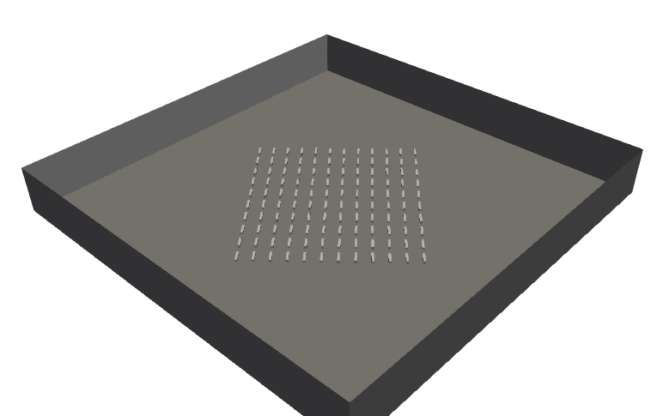
I. LES model
Model setup:
Solver: AVBP for LES of compressible flows and low-Mach flows
Subgrid-scale model: WALE (wall adapted)
$$h=50 m$$
$$L=420m$$
Unstructured mesh of 90 millions tetrahedra:
Refinement near obstacles:
30 cm $⇔$ at least 15 cells per obstacle edge
Inflow
Symmetry
$$d_{inlet}=80 m$$
Wall laws
Model computational cost:
{60s spin-up + 200s}
$⟺$ 20 000 hCPU
Symmetry
Outflow
$⇒$ The LES model is too expensive for data assimilation
Eliott Lumet et al. 2022 – Data assimilation for microscale pollutant atmospheric dispersion

Slide 8
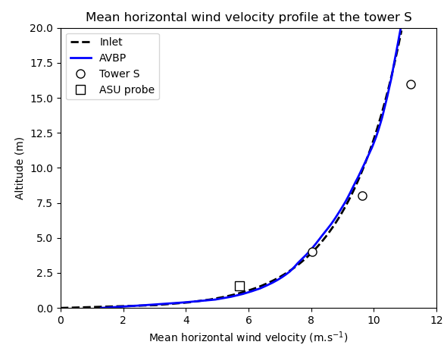
I. LES model
Inflow boundary condition
Prescribed mean velocity profile:
With: $z_{0}=0.075 m$ (data from Yee and Biltoft. 2004)
$u_{∗}=0.730 m.s^{−1}$ (fitted on experimental data)
Constant wind direction:
$$U_{inlet}\left(z\right)=\frac{u_{∗}}{κ}\ln\left(\frac{z+z_{0}}{z_{0}}\right)$$
$$∀z, α_{inlet}\left(z\right)=−40.95°$$
Eliott Lumet et al. 2022 – Data assimilation for microscale pollutant atmospheric dispersion

Slide 9
I. LES model
Inflow boundary condition
Prescribed mean velocity profile:
With: $z_{0}=0.075 m$ (data from Yee and Biltoft. 2004)
$u_{∗}=0.730 m.s^{−1}$ (fitted on experimental data)
Constant wind direction:
$$U_{inlet}\left(z\right)=\frac{u_{∗}}{κ}\ln\left(\frac{z+z_{0}}{z_{0}}\right)$$
$$∀z, α_{inlet}\left(z\right)=−40.95°$$
Turbulence injection:
Method: Synthetic eddy method (Smirnov et al. 2001)

Slide 10
I. LES model
Selection of uncertain parameters
Objective: Choose which parameters should be corrected by Data Assimilation
- Inlet mean wind direction: $α_{inlet}$
- Friction velocity imposed in the inlet log-profile: $u_{∗}$
- Ground roughness: $z_{0}$
- Reynolds stress tensor imposed with the turbulence injection: $R$
i. The site topography is
assumed to be well known
Boundary
Conditions
ii. Turbulence injection parameter
do not have significant impacts
on predictions
Pollutant source
- Source location: $x_{source}$
- Pollutant emissions: $Q_{source}(t)$
$⇐$ Not considered in this first study
Modelling
error
- Numerical scheme
- SGS model
$⇐$These inner parameters have less impact than BCs parameters
$⇒$ Reconstruction of only two parameters: $θ=\left(α_{inlet},u_{∗}\right)$
Eliott Lumet et al. 2022 – Data assimilation for microscale pollutant atmospheric dispersion

Slide 11
II. Surrogate model
Training process
Ensemble of LES to sample the parameter space: budget of 100 LES $⇔$ 2 500 000 hCPU
Halton sequence: splitted into train and test samples
New parameters
$$\left(α_{inlet}, u_{∗}\right)$$
Surrogate model
Fast prediction of $\overline{c}$
RBF Interpolator (Scipy)
Interpolates as a linear combination of radial basis functions
One regression problem per grid point (scales badly)
Need to calibrate the RBF surrogate using the training samples
$⇒$ We limit this first study to a horizontal cut $\left(z=1.6 m\right)$ of the concentration field

Slide 12
II. Surrogate model
Validation process:
Comparison of concentration field predictions: worst case
RMSE = 9.07 ppm $⇒$ The error is large on the plume edge
This test sample is very close to the parameter space edge
Eliott Lumet et al. 2022 – Data assimilation for microscale pollutant atmospheric dispersion

Slide 13
II. Surrogate model
Validation process:
Comparison of concentration field predictions: best case
RMSE = 0.19 ppm $⇒$ Building interactions are well reproduced
1 surrogate integration $≈$ 0.125s with 1 CPU
Eliott Lumet et al. 2022 – Data assimilation for microscale pollutant atmospheric dispersion

Slide 14
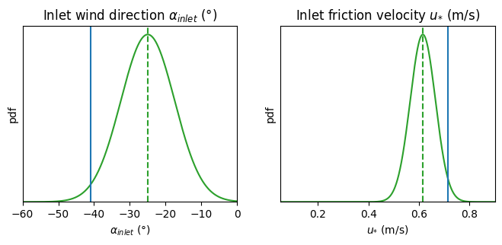
III. Data assimilation results
Synthetic experiment:
Prior parameters knowledge
$$θ^{b}=\left(α_{inlet}^{b},u_{∗}^{b} \right)$$
$$(−25°, 0.615 m.s^{−1})$$
Surrogate model
$$\overline{c^{b}}$$
DA
$$θ^{b}$$
$$θ^{a}$$
?
?
$$y$$
Sensors
Synthetic observations
Truth parameters
$$θ^{t}=\left(α_{inlet}^{t},u_{∗}^{t} \right)$$
$$(−40.95°, 0.715 m.s^{−1})$$
Surrogate model
$$\overline{c^{t}}$$
Truth system state
= known
Truth system state
= unknown
$⇒$ Are we able to retrieve the correct parameters?
$⇒$Is the analysis $θ^{a}$equal to the truth $θ^{t}$?
Eliott Lumet et al. 2022 – Data assimilation for microscale pollutant atmospheric dispersion

Slide 15
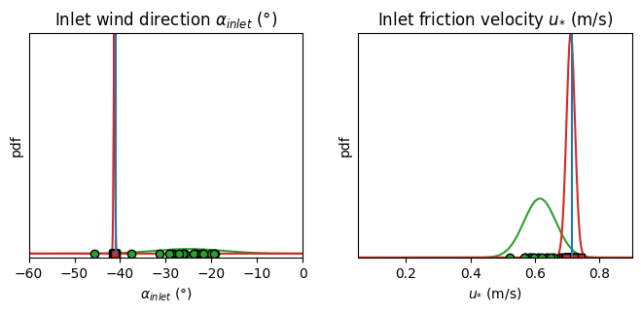
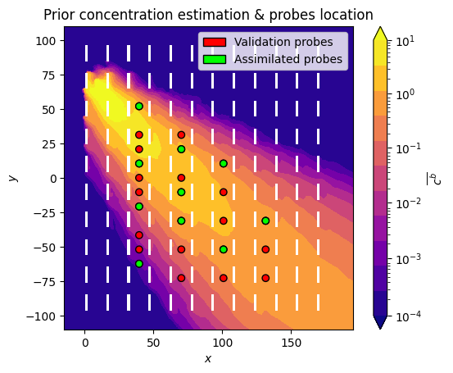
III. Data assimilation results
Parameter estimation results:
DA algorithm: Iterative Ensemble Kalman Filter
Number of members: $N_{e}=20$
Number of sensors: $N_{o}=10$
Assimilation
$⇒$ The data assimilation algorithm works well and is able
to correct the inflow boundary conditions.
Eliott Lumet et al. 2022 – Data assimilation for microscale pollutant atmospheric dispersion

Slide 16
III. Data assimilation results
Concentration results field:
Mean concentration isolines comparison:
$⇒$ The plume shape is
well estimated
$⇒$ Algorithm execution
time = 100s
Eliott Lumet et al. 2022 – Data assimilation for microscale pollutant atmospheric dispersion

Slide 17
Conclusion
Take-home messages
1) Data assimilation provides a powerful framework to reduce inflow boundary condition uncertainties in microscale LES simulations.
2) Replacing the LES model by a surrogate model opens the way towards a real-time data assimilation framework to better predict plume behaviour in case of accident.
Perspectives
Extend the approach to 3D fields by using state-of-the-art surrogate model (dimension reduction combined with gaussian process regression)
Extend the approach to estimate source uncertainties
Use model sensitivity analysis for optimal sensor placement
Eliott Lumet et al. 2022 – Data assimilation for microscale pollutant atmospheric dispersion

Slide 18
Appendices

Slide 19
Appendice I: Why do we use LES instead of RANS?
Technical & historical reasons specific to my lab
At CERFACS, AVBP a LES solver is developed and maintained
In my team, a LES intercomparison of the MUST case has already been performed (Rochoux et al. 2021)
LES superiority for UQ perspectives
LES model requires less parametrization
LES model errors are less important (LES intercomparison study)
$⇒$ Easier Uncertainty Quantification framework
LES would allow to further development in the future
We kept unsteady moving averages to try outs sensor positioning methods for plume developing scenario
LES allow to predict more fields than RANS:
Concentration high order statistics, peak concentration: useful data for analysis
Frozen AVBP: need for stress tensors for specific surrogate modeling
Eliott Lumet et al. 2022 – Data assimilation for microscale pollutant atmospheric dispersion

Slide 20
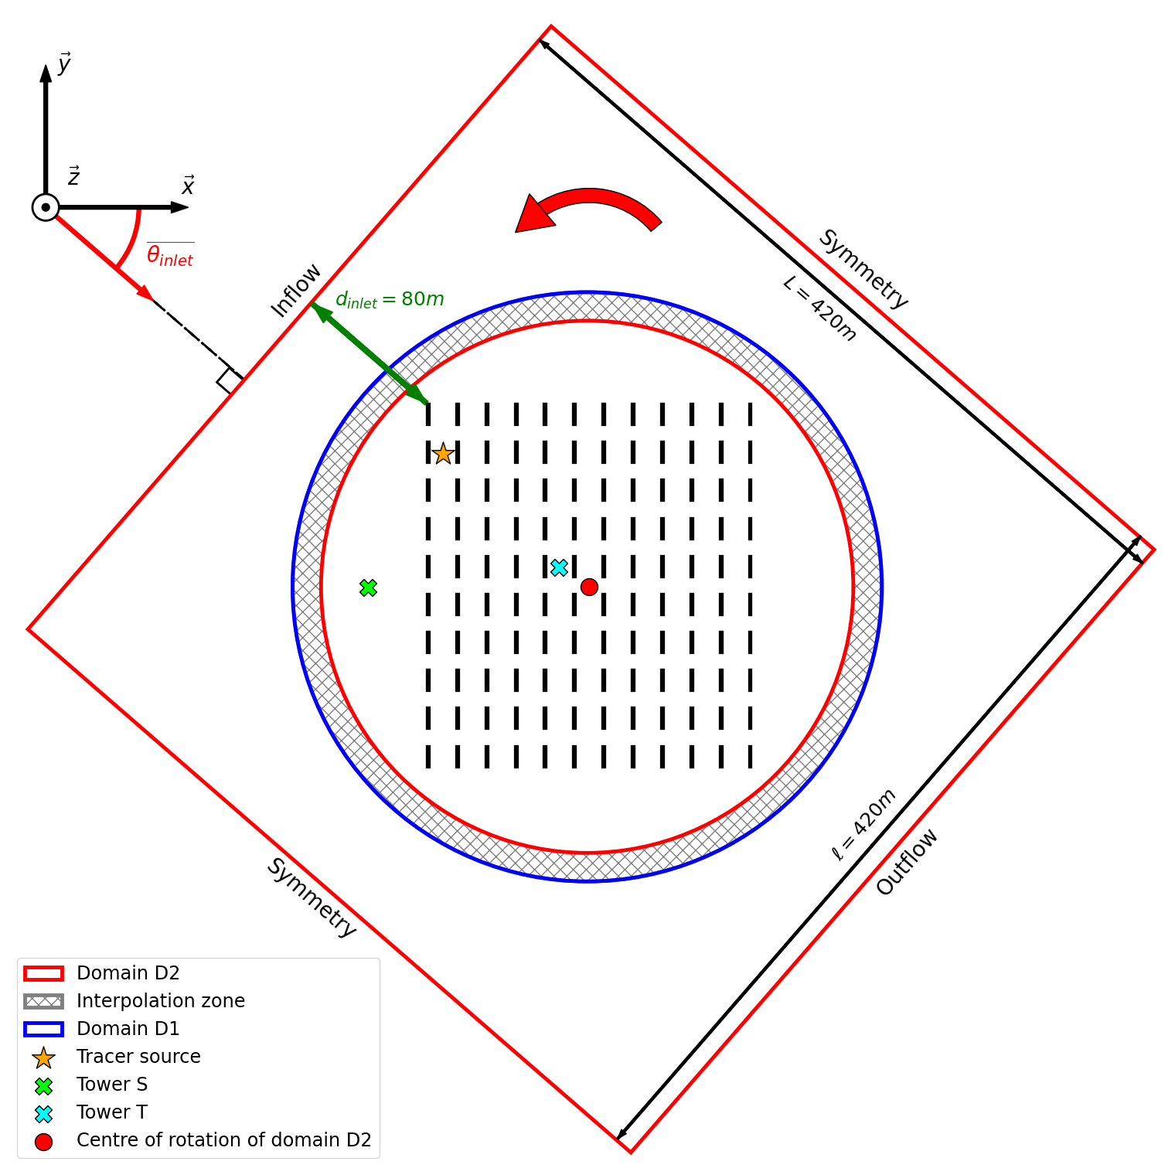
Appendice II: TurboMUST
Model adaptation
Domain rotation using TurboAVBP:
Goal: Keep symmetry BCs // to the flow streamwise direction
Principle:
- Split the domain in two
- Coupled resolution on both domain
Eliott Lumet et al. 2022 – Data assimilation for microscale pollutant atmospheric dispersion

Slide 21
Appendice II: TurboMUST
Model results
Metrics computed for all sensors where: $\overline{c}>c_{treshold}=0.04 ppm$
Metric | FB (ppm) | RMSE (ppm) | FAC2 | MG | VG
Perfect model | 0 | 0 | 100% | 1 | 1
LES Model | -0.048 | 0.002 | 91% | 1.24 | 1.57
Eliott Lumet et al. 2022 – Data assimilation for microscale pollutant atmospheric dispersion

Slide 22
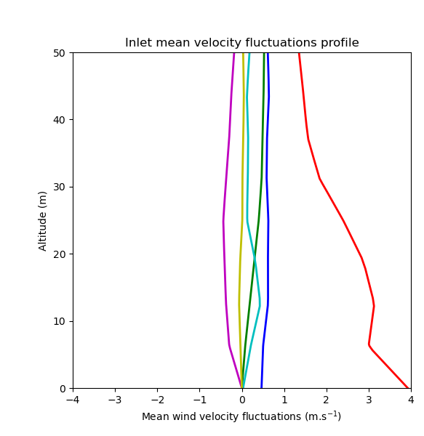
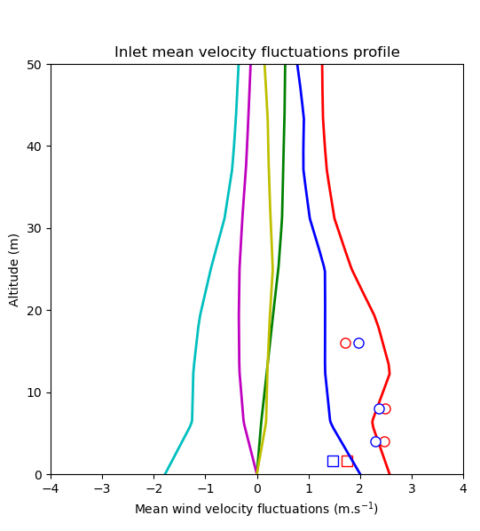
Appendice III: Turbulence injection method
$$\left(θ_{inlet}^{ref}, u_{∗}^{ref}\right)=(0°, 0,715 m/s)$$
$$\left(θ_{inlet}, u_{∗}\right)=(−40,95°, 0,730 m/s)$$
Principle
Good agreement with experimental fluctuations data
Precursor
Simulation
CL périodiques
Champ libre (sans obstacles)
Maillage quads
Convergence statistique
$$\left(θ_{inlet}^{ref}, u_{∗}^{ref}\right)$$
$R^{ref}=f(z)$
Rescaling
$$\left(θ_{inlet}, u_{∗}\right)$$
$$R=f(z)$$
Turbulence Injection
Eliott Lumet et al. 2022 – Data assimilation for microscale pollutant atmospheric dispersion

Slide 23
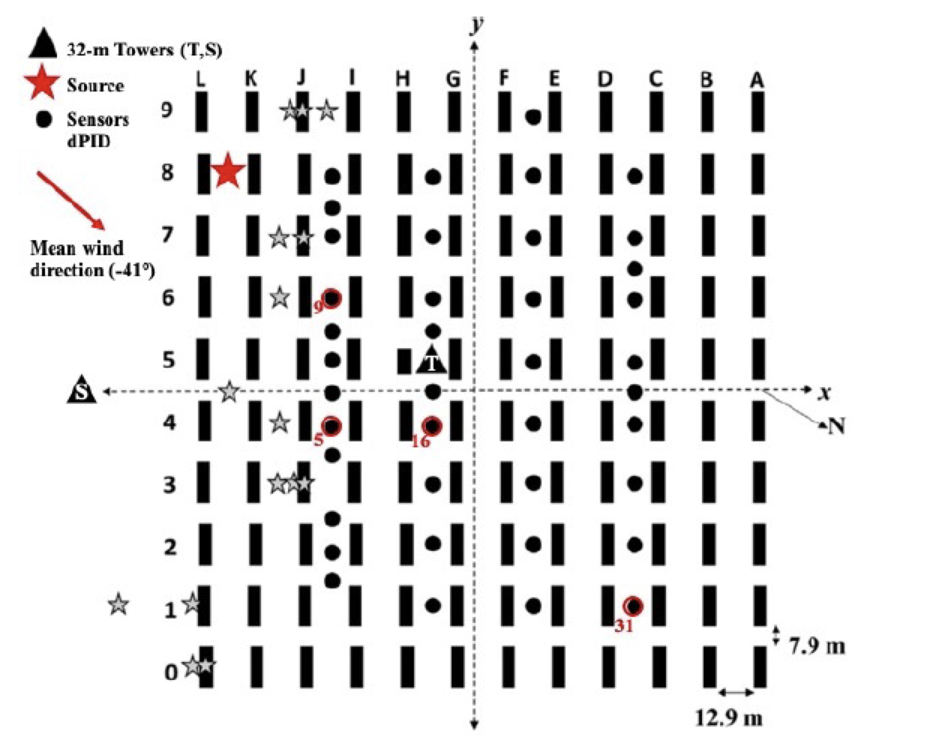
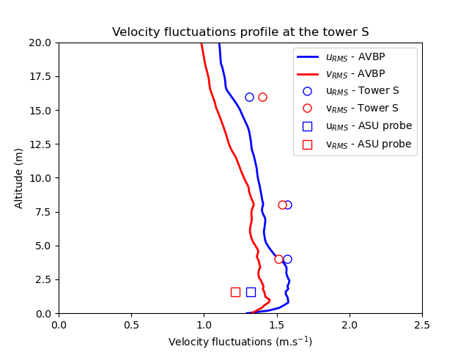
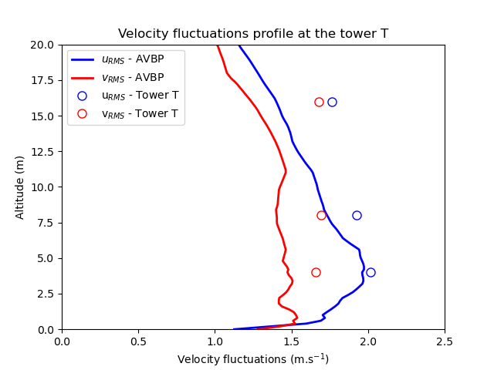
Appendice III: Turbulence injection method
Results
Velocity fluctuations profiles
Tower S | Tower T
Overall good agreement with experimental data
Lack of TKE over the canopy
Eliott Lumet et al. 2022 – Data assimilation for microscale pollutant atmospheric dispersion

Slide 24
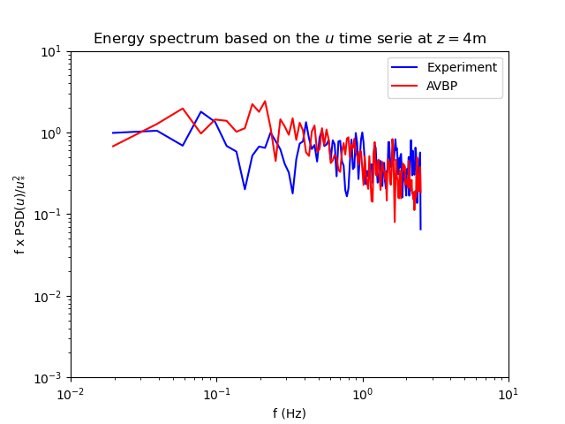
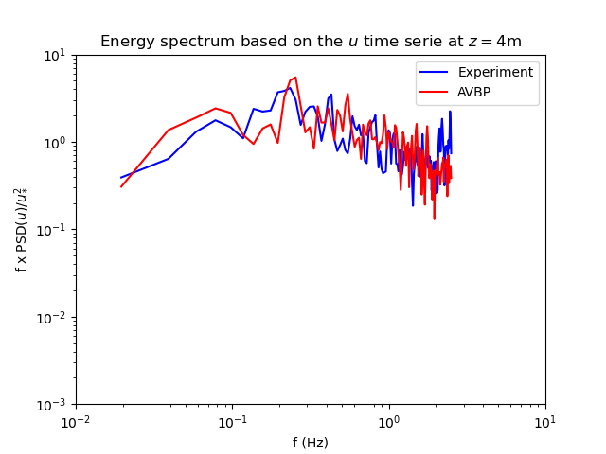
Appendice III: Turbulence injection method
Results
Turbulence spectrum
Tower S | Tower T
Fine reproduction of the turbulence
Eliott Lumet et al. 2022 – Data assimilation for microscale pollutant atmospheric dispersion

Slide 25
Appendice IV: Uncertain parameter space definition
Perturbed Physics Ensemble
Goal: Sample the parameter space to build a surrogate model
Method: Halton sequence (low-discrepancy)
What ranges of variation for uncertain parameters?
Microclimatology based on 12 days of acquisition by one MUST SAMS station:
Constraints on the wind direction:
- Limited simulations budget
- The plume must pass through the containers
$$\left\{\begin{aligned}α_{inlet}∈\left[−60, 0\right]° (MUST) \\ u_{∗}∈\left[0.07, 0.89\right] m.s^{−1}\end{aligned}\right.$$
$$⇒$$
Eliott Lumet et al. 2022 – Data assimilation for microscale pollutant atmospheric dispersion

Slide 26
Appendice V: Surrogate model results
Metrics averaged over all the validation samples:
For each sample the metrics are computed by comparison between the surrogate and the LES estimations
The scores below are the averages of all these metrics computations
Metric | MAE (ppm) | RMSE (ppm) | MG | VG | FMS(1ppm)
Score | 0.189 | 1.585 | 0.949 | 1.105 | 0.878
Eliott Lumet et al. 2022 – Data assimilation for microscale pollutant atmospheric dispersion

Slide 27
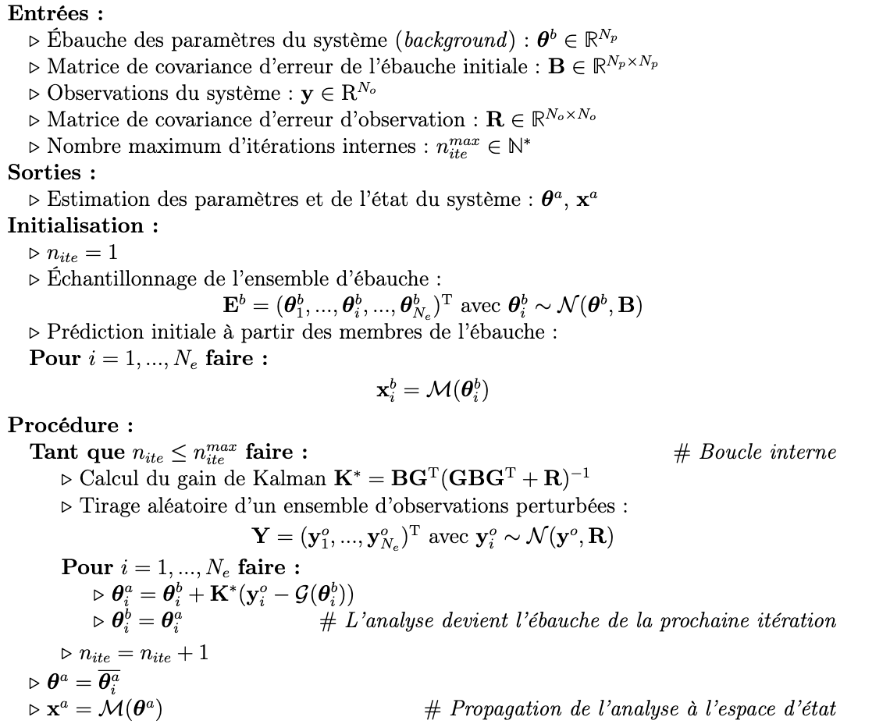
Appendice VI: IEnKF algorithm for parameter estimation
Eliott Lumet et al. 2022 – Data assimilation for microscale pollutant atmospheric dispersion

Slide 28
Appendice VII: Concentration anamorphosis
Issue: $c$ is always positive $⇒$ $c≁𝒩\left(μ,σ^{2}\right)⇒$ $\left(c−𝒢\left(θ_{t}\right)\right)≁𝒩\left(μ,σ^{2}\right)⇒$The EnKF hypothesis are not verified
Solution: - Assume that $c$ and thus $\left(c−𝒢\left(θ_{t}\right)\right)$ follow a log-normal distribution
- Assimilate “log-concentration” obs: $y=\ln{(\max\left(c,0\right)+c_{t})}$ so that $\left(y−𝒢\left(θ_{t}\right)\right)\sim 𝒩\left(μ,σ^{2}\right)$
Changes in the EnKF algorithm:
Sample log-concentration observations with correct moments:
$∀i, 1≤i≤N_{e}, y_{i}^{o}\sim 𝒩\left(μ,σ^{2}\right)$, with $μ=\ln\left(c\right)−\frac{1}{2}σ^{2}$ and $σ=\ln\left(1+{\left(\frac{σ\left(c\right)}{c}\right)}^{2}\right)$
and $σ\left(c\right)=0.04 ppm$
Note that the observation error covariance matrix R is also changed by the anamophosis
Update the general observation operator:
Liu et al.
2017
Detection threshold: Avoid giving too much weight to low concentrations obs
$$ℳ$$
$$ℋ$$
$$𝒢: θ$$
$$x$$
$$c$$
$$y=\ln{(\max\left(c,0\right)+c_{t})}$$
Eliott Lumet et al. 2022 – Data assimilation for microscale pollutant atmospheric dispersion

Slide 29
Appendice VIII: Other Data Assimilation results
Metrics results:
Quantify the misft between the truth concentration field and the ones from data assimilation
Metric | FB (ppm) | RMSE (ppm) | VG
Background | -3.12e-01 | 1.75E+01 | 4.34
Analysis | -3.55E-04 | 1.22E-02 | 1.00
Eliott Lumet et al. 2022 – Data assimilation for microscale pollutant atmospheric dispersion

Slide 30
Appendice VIII: Other Data Assimilation results
Concentration fields results:
Eliott Lumet et al. 2022 – Data assimilation for microscale pollutant atmospheric dispersion

Slide 31
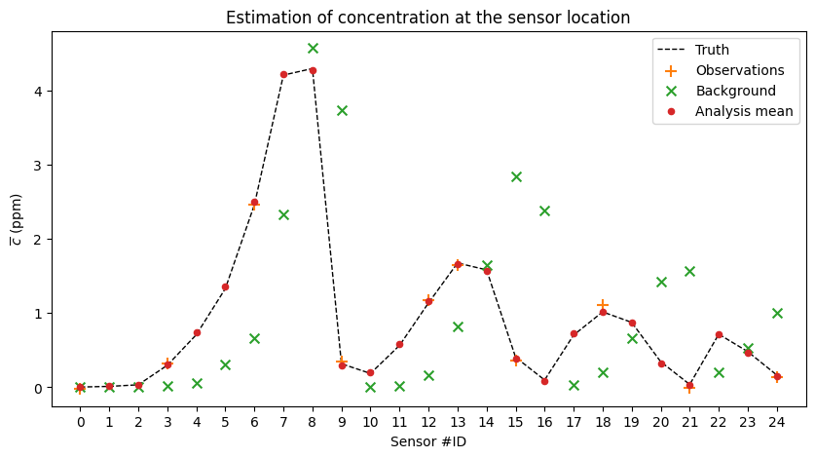
Appendice VIII: Other Data Assimilation results
Concentration estimations at probes locations:
Eliott Lumet et al. 2022 – Data assimilation for microscale pollutant atmospheric dispersion

Slide 32
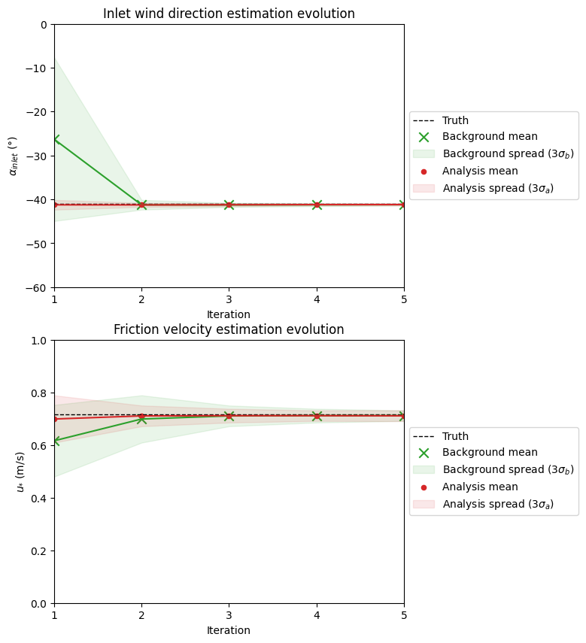
Appendice VIII: Other Data Assimilation results
Evolution of the parameters estimation:
Eliott Lumet et al. 2022 – Data assimilation for microscale pollutant atmospheric dispersion

Slide 33
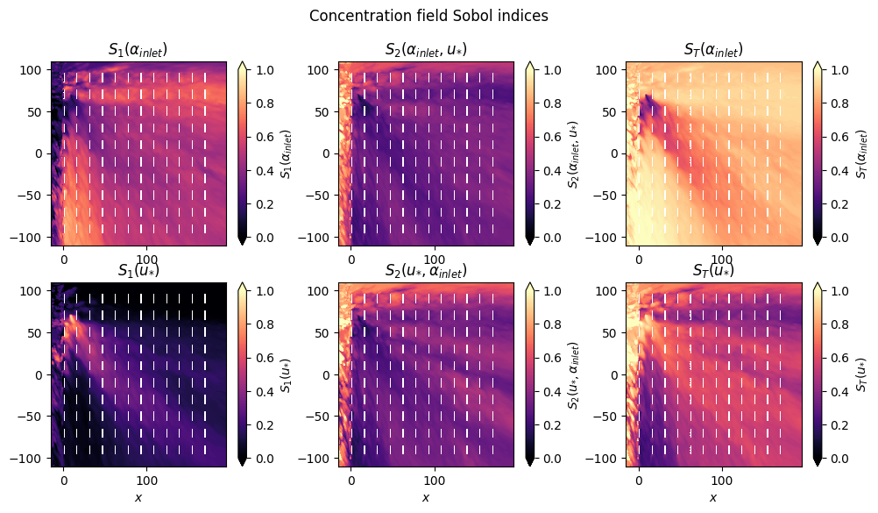
Appendice IX: Sensitivity Analysis
Sobol Indices:
Eliott Lumet et al. 2022 – Data assimilation for microscale pollutant atmospheric dispersion

